Slide 1
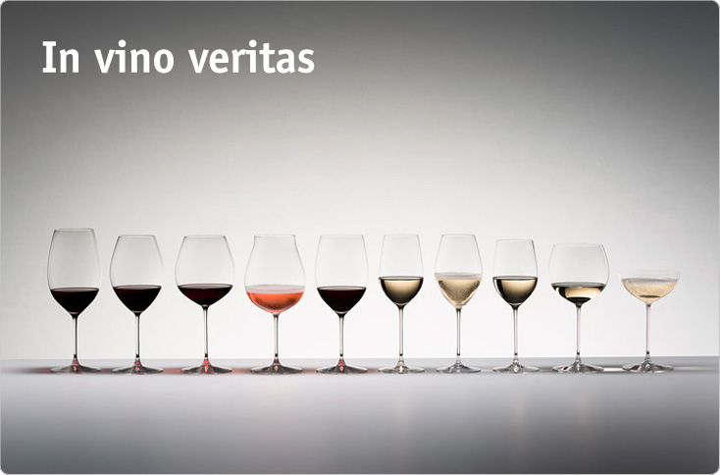
GA Data Science Class
Final Project
Wen Lu
Mar 16 2016
Quotations are commonly printed as a means of inspiration and to invoke philosophical thoughts from the reader.

Slide 2
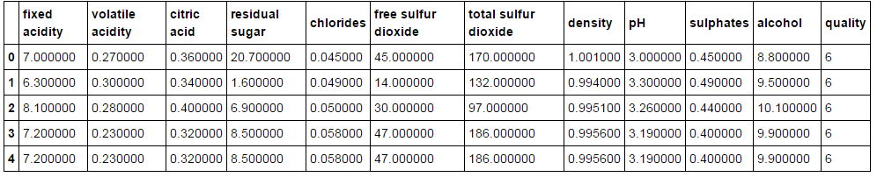
About the Data
Two datasets – Red & White Wine
Source: UCI Machine Learning Repository
11 physiochemical attributes
No missing values
In different units of measurement

Slide 3
Looking into the features

Slide 4
Findings
Outliers
Expected levels for some of the physiochemical attributes
1,500 - 14,500 mg/L tartaric acid; 0 - 500 mg/L citric acid; 0 - 3 g/L volatile acid; 10 - 350 mg/L sulphates;
Overlapping features
"The predominant fixed acids found in wines are tartaric, malic, citric, and succinic.“
total SO₂ = free SO₂ + bound SO₂

Slide 5
What I did
Drop 'citric acid‘ and 'free sulfur dioxide'
Replace with a binary column for quality
Feature Standardization

Slide 6
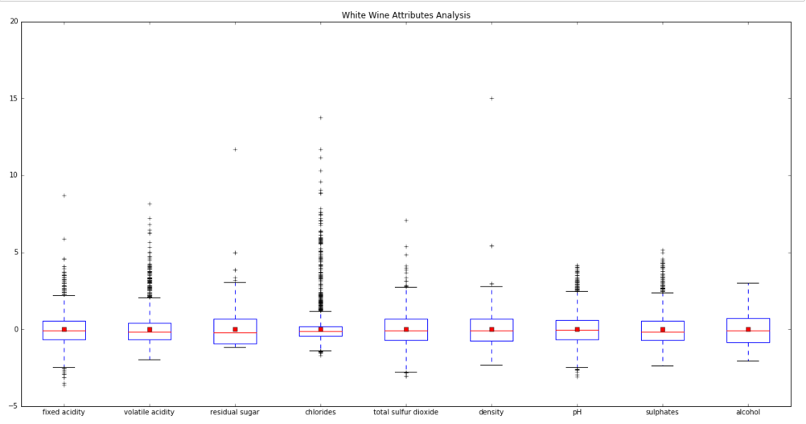
Attribute Analysis using Box Plot

Slide 7
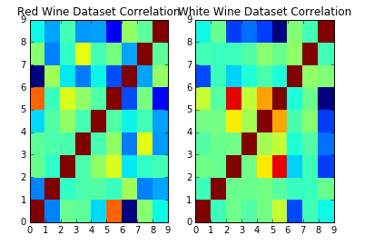
Feaure Correlation

Slide 8
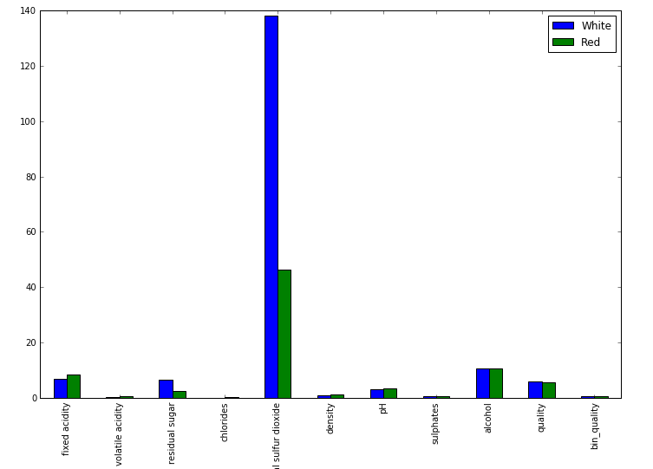
Feature Comparison

Slide 9
Apply Both Supervised and Unsupervised Learning Models
Using Dummy Classifier

Slide 10
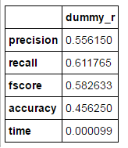
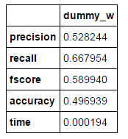
Process
Train_Test Data Split
Dummy Classifier
Benchmark

Slide 11
Logistic Regression
Randome Forest
K-Means Clustering
L2 - Ridge Regularization
GridSearchCV

Slide 12
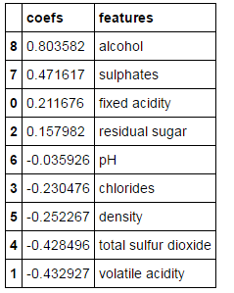
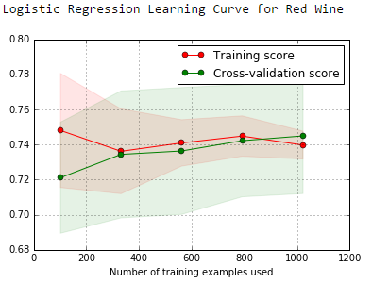
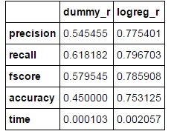
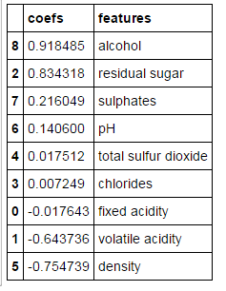
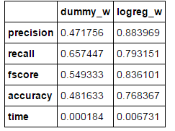
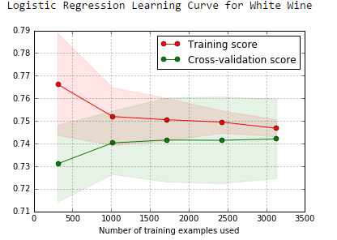
Logistic Regression Performance

Slide 13
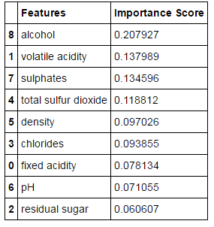
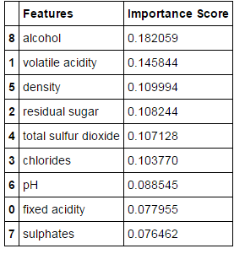
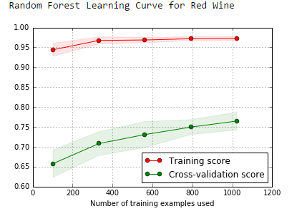
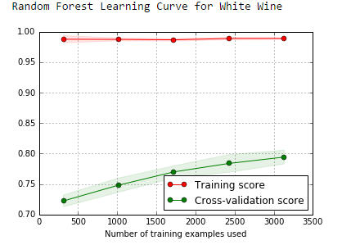
Randome Forest Performance

Slide 14
K-Means Clustering
StandardScaler
- On both datasets
Create a ‘Type’ column
- To distinguish red and white wines after they are concatenate
- Type 1 is White Wine; Type 2 is Red Wine.
Concatenate
- Into a master ‘Wine’ dataset
Visualize
- Parallel coordinates
Inertia and silhouette score
Determine the best n_clusters
N=2
Clustering Result

Slide 15
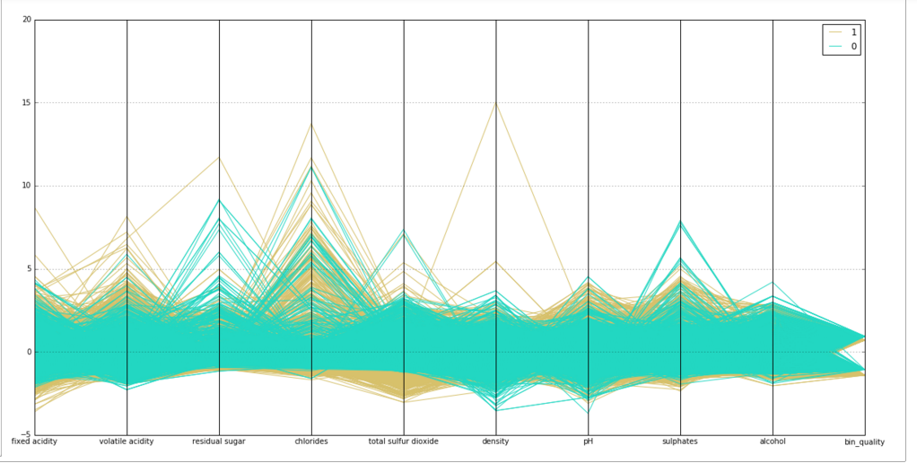
1 = White Wine 2= Red Wine

Slide 16
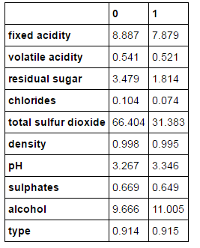
Clustering
Result

Slide 17
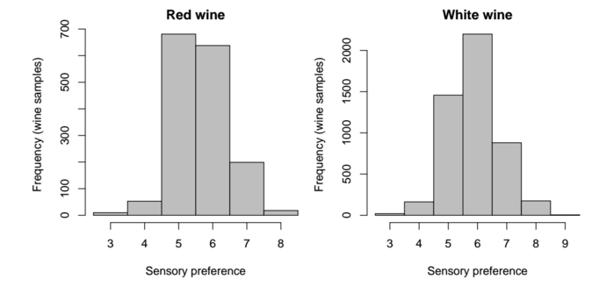
Limitations and Extensions
Limitations:
Production year and evaluation year
White wine data size is 3X of red wine
5 cut-off line (most wines get scores 5 and 6)
Extended Project:
- Predict wine geographic orgins based on both physiochemical characters and chemical components

Slide 18
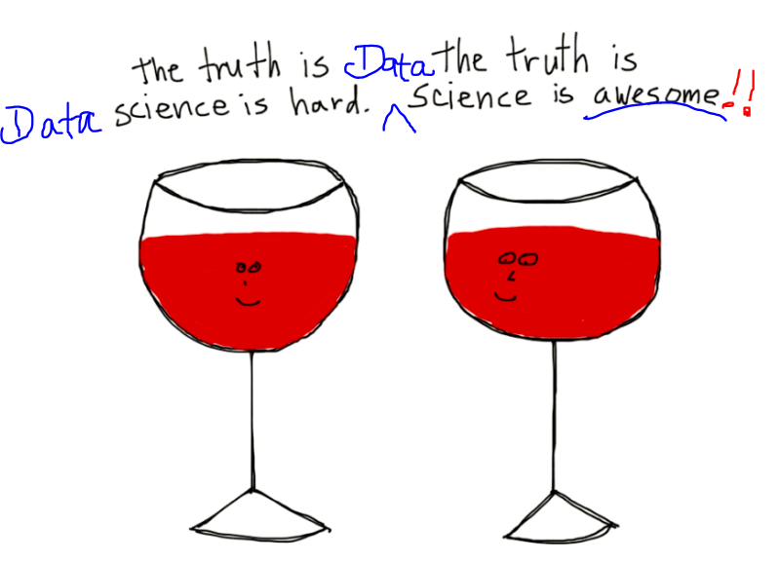
Questions

